Slide 1
Introduction to Computer Graphics with WebGL
Ed Angel
Professor Emeritus of Computer Science
Founding Director, Arts, Research, Technology and Science Laboratory
University of New Mexico
Angel and Shreiner: Interactive Computer Graphics 7E © Addison-Wesley 2015

Slide 2
Per Vertex and Per Fragment Shaders
Ed Angel
Professor Emeritus of Computer Science
University of New Mexico
Angel and Shreiner: Interactive Computer Graphics 7E © Addison-Wesley 2015

Slide 3
Vertex Lighting Shaders I
// vertex shader
attribute vec4 vPosition;
attribute vec4 vNormal;
varying vec4 fColor;
uniform vec4 ambientProduct, diffuseProduct, specularProduct;
uniform mat4 modelViewMatrix;
uniform mat4 projectionMatrix;
uniform vec4 lightPosition;
uniform float shininess;
void main()
{
Angel and Shreiner: Interactive Computer Graphics 7E © Addison-Wesley 2015

Slide 4
Vertex Lighting Shaders II
vec3 pos = -(modelViewMatrix * vPosition).xyz;
vec3 light = lightPosition.xyz;
vec3 L = normalize( light - pos );
vec3 E = normalize( -pos );
vec3 H = normalize( L + E );
// Transform vertex normal into eye coordinates
vec3 N = normalize( (modelViewMatrix*vNormal).xyz);
// Compute terms in the illumination equation
Angel and Shreiner: Interactive Computer Graphics 7E © Addison-Wesley 2015

Slide 5
Vertex Lighting Shaders III
// Compute terms in the illumination equation
vec4 ambient = AmbientProduct;
float Kd = max( dot(L, N), 0.0 );
vec4 diffuse = Kd*DiffuseProduct;
float Ks = pow( max(dot(N, H), 0.0), Shininess );
vec4 specular = Ks * SpecularProduct;
if( dot(L, N) < 0.0 ) specular = vec4(0.0, 0.0, 0.0, 1.0);
gl_Position = Projection * ModelView * vPosition;
color = ambient + diffuse + specular;
color.a = 1.0;
}
Angel and Shreiner: Interactive Computer Graphics 7E © Addison-Wesley 2015

Slide 6
Vertex Lighting Shaders IV
// fragment shader
precision mediump float;
varying vec4 fColor;
voidmain()
{
gl_FragColor = fColor;
}
Angel and Shreiner: Interactive Computer Graphics 7E © Addison-Wesley 2015

Slide 7
Fragment Lighting Shaders I
// vertex shader
attribute vec4 vPosition;
attribute vec4 vNormal;
varying vec3 N, L, E;
uniform mat4 modelViewMatrix;
uniform mat4 projectionMatrix;
uniform vec4 lightPosition;
Angel and Shreiner: Interactive Computer Graphics 7E © Addison-Wesley 2015

Slide 8
Fragment Lighting Shaders II
void main()
{
vec3 pos = -(modelViewMatrix * vPosition).xyz;
vec3 light = lightPosition.xyz;
L = normalize( light - pos );
E = -pos;
N = normalize( (modelViewMatrix*vNormal).xyz);
gl_Position = projectionMatrix * modelViewMatrix * vPosition;
};
Angel and Shreiner: Interactive Computer Graphics 7E © Addison-Wesley 2015

Slide 9
Fragment Lighting Shaders III
// fragment shader
precision mediump float;
uniform vec4 ambientProduct;
uniform vec4 diffuseProduct;
uniform vec4 specularProduct;
uniform float shininess;
varying vec3 N, L, E;
void main()
{
Angel and Shreiner: Interactive Computer Graphics 7E © Addison-Wesley 2015

Slide 10
Fragment Lighting Shaders IV
vec4 fColor;
vec3 H = normalize( L + E );
vec4 ambient = ambientProduct;
float Kd = max( dot(L, N), 0.0 );
vec4 diffuse = Kd*diffuseProduct;
float Ks = pow( max(dot(N, H), 0.0), shininess );
vec4 specular = Ks * specularProduct;
if( dot(L, N) < 0.0 ) specular = vec4(0.0, 0.0, 0.0, 1.0);
fColor = ambient + diffuse +specular;
fColor.a = 1.0;
gl_FragColor = fColor;
}
Angel and Shreiner: Interactive Computer Graphics 7E © Addison-Wesley 2015

Slide 11

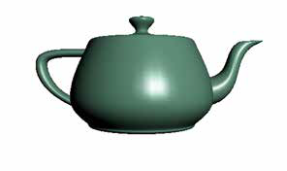
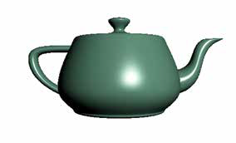
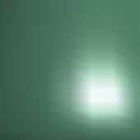
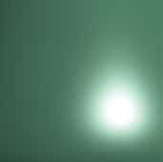
Teapot Examples
Angel and Shreiner: Interactive Computer Graphics 7E © Addison-Wesley 2015

